Slide 1



Verification and Validation:
Overview
Joseph L. Hellerstein^{1,2} and Herbert M Sauro²
¹eScience Institute
²Department of Computer Science & Engineering
³Department of Bioengineering
July, 2021

Slide 2
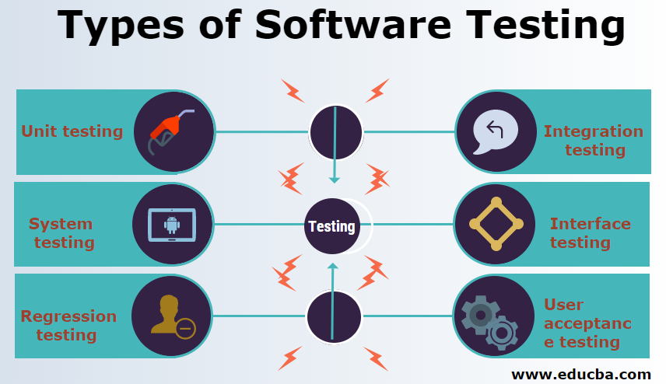
Static Errors

Slide 3
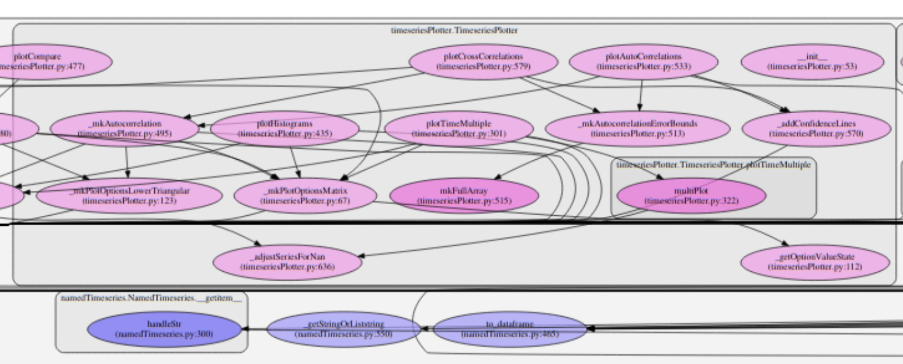
Testing a Software Package (SBstoat)
 | No. Modules (Files) | Lines of Code
Package codes | 26 | ~6,000
Test codes | 33 | ~4,000
TOTAL | 59 | ~10,000
Call graph for module
timeseriesPlotter

Slide 4
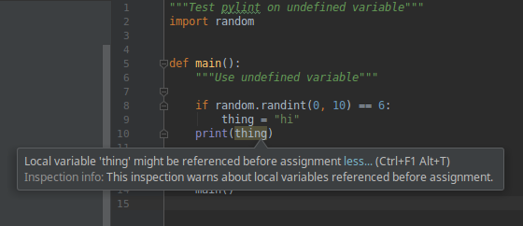
Software Linting Catches Static Errors
Static error: An error that can be detected without executing program codes.

Slide 5
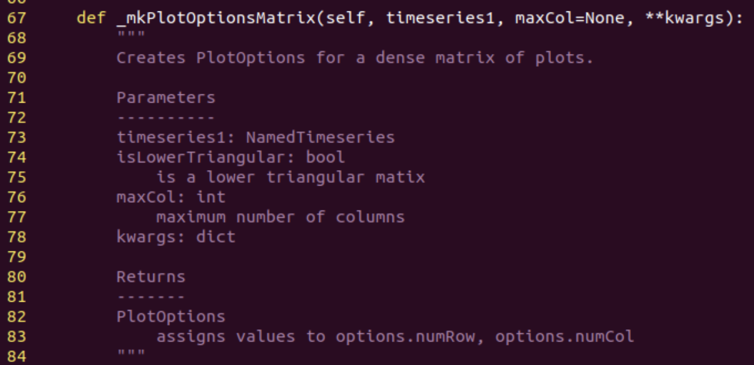
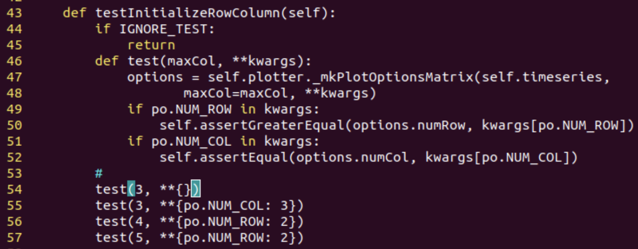
Unit Testing
 | No. Modules (Files) | Lines of Code
Package codes | 26 | ~6,000
Test codes | 33 | ~4,000
TOTAL | 59 | ~10,000
Mostly unit tests
Separate tests for each function ensures that all statements are executed.
Test code calls function.
Test code has assertions that verify predicates.

Slide 6
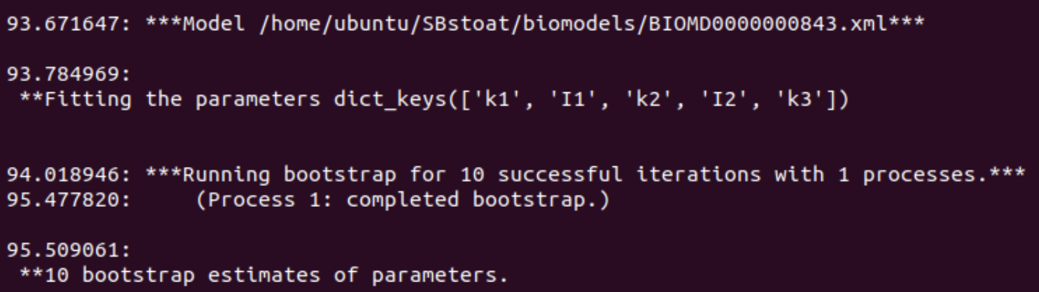
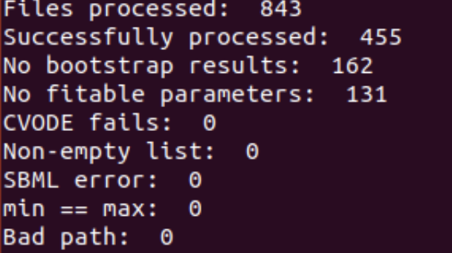
System Testing
Verify that codes operate as expected under normal conditions.
SBstoat System Testing: process ~800 models in BioModels.
Collect success/failure for each model.
Summary

Slide 7
Static Testing of BioMedical Models

Slide 8
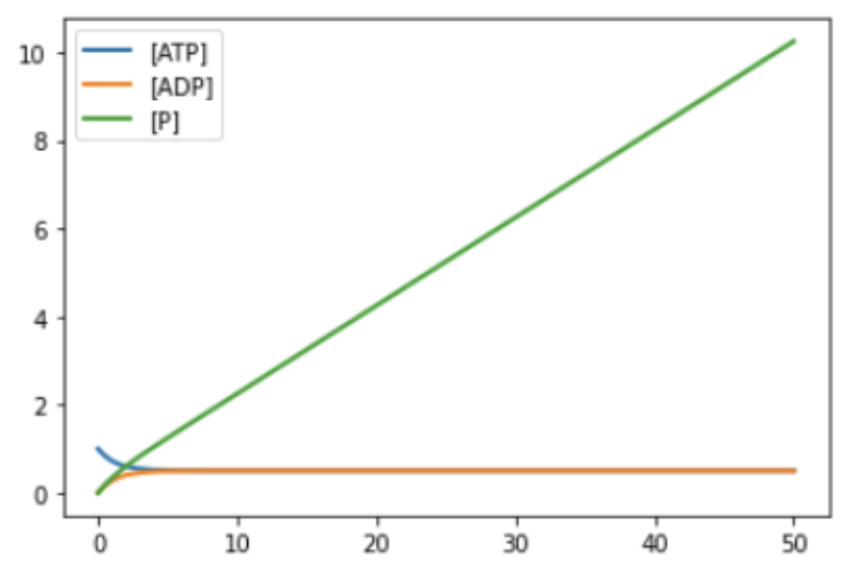
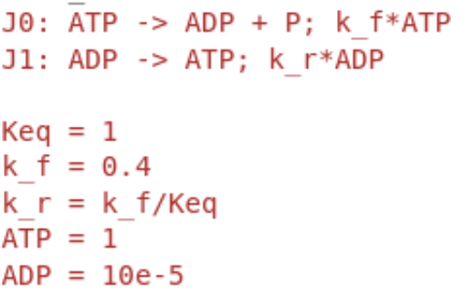
What’s Wrong With This Model?
Exercise: Why does [P] increase without bound?

Slide 9
What’s Wrong With This Model?
Why does [P] increase without bound?
We have treated inorganic phosphate inconsistently.
P is included in J0
P is not included in J1
Broadly referred to as a mass balance error.

Slide 10

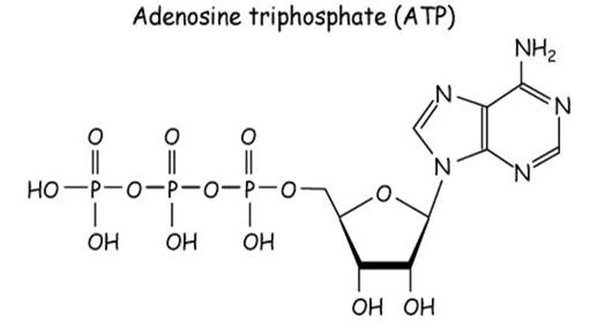

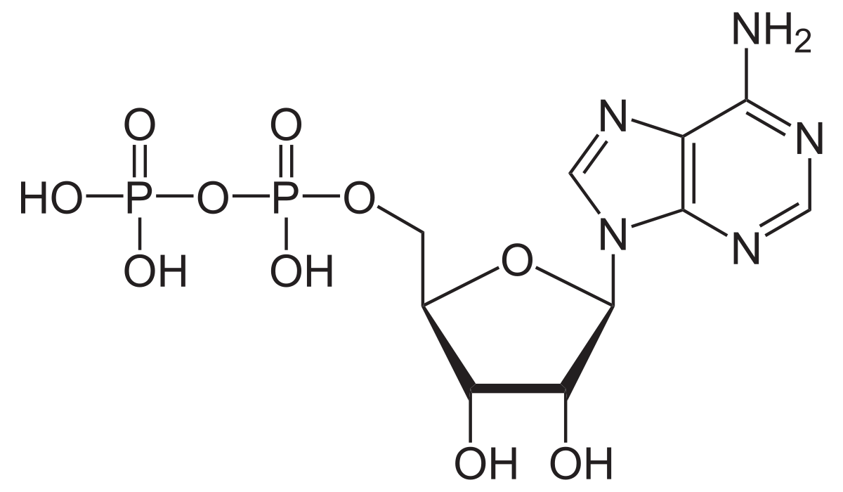
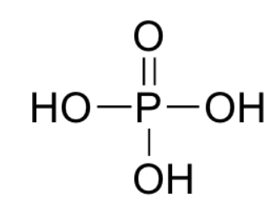
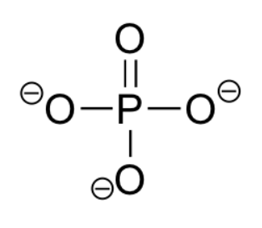

What Do We Mean by Mass Balance Errors
Is there mass missing in this reaction?
ATP
{
Has extra O and 2H.
In this reaction?
ADP
P?
Mass balanced.
Notes:
Even if we ignore the issue of protonation (which Pi), we still have a missing O when we add the atoms in Pi to ADP. This is because we haven’t included water in the reaction.

Slide 11

True Mass Balance May Not Be Desirable
True mass balance precludes having implicit chemical species
Present in large quantities so that concentration does not change (e.g., water)
Appeal of implicit chemical species
Simpler reactions
More efficient simulation

Slide 12
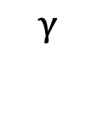


Moieties
A moiety refers to a collection of chemical species that have similar chemical functions.
Example: Variations in the chemical structure of inorganic phosphates.
Instances of inorganic phosphate moieties

Slide 13


Moiety Analysis
Moiety analysis provides a way to check consistency of reactions while having flexibility about the exact chemical formula
Chemical species are represented by their moiety structure
A reaction is “moiety preserving” if the counts of moieties in the reactants is the same as the counts in the products.
Molecule
Moiety | ATP | ADP | P
A | 1 | 1 | 0
P | 3 | 2 | 1
Moiety | ATP | ADP + P | Equal
A | 1 | 1 | Yes
P | 3 | 3 | Yes
Moiety | ATP | ADP | Equal
A | 1 | 1 | Yes
P | 3 | 2 | No
Implicit chemical species: P

Slide 14
Challenges With Moiety Analysis
Requires database of moiety structures for chemical species
Requires annotating models to identify chemical species
Moiety | ATP | ADP | P
A | 1 | 1 | 0
P | 3 | 2 | 1

Slide 15


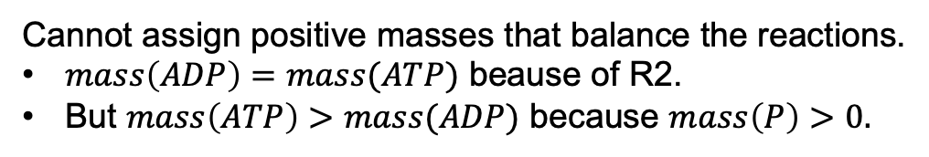

Stoichiometric inconsistency: There is no assignment of positive values of mass to chemical species such that all reactions are mass balanced.
Example

Slide 16




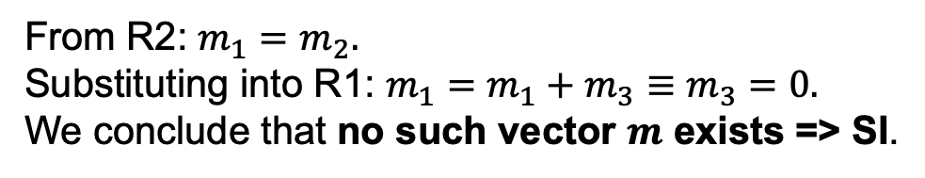
Finding Stoichiometric Inconsistencies (SI)
Stoichiometric inconsistency: There is no assignment of positive values of mass to chemical species such that all reactions are mass balanced.
1. Construct the mass equations for the reactions.
Is there way to detect SI in general?

Slide 17
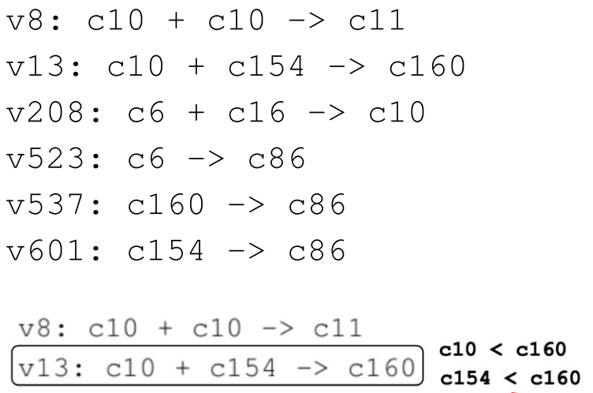

Finding More Complicated Mass Balance Errors
Part of ErbB signaling (BioModels 255)

Slide 18


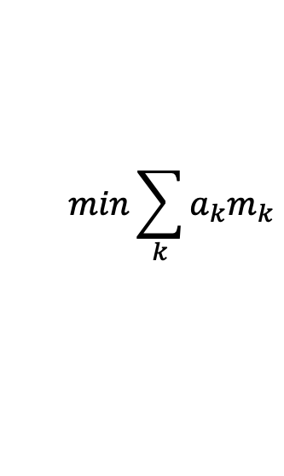
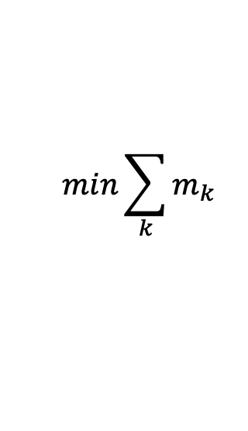

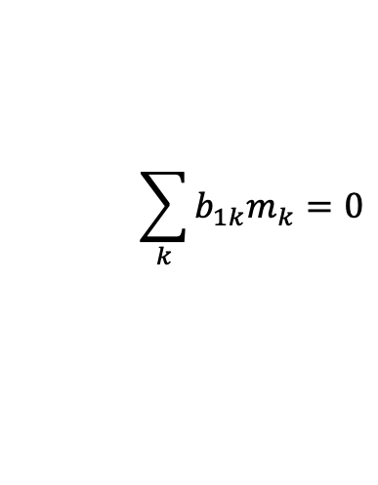
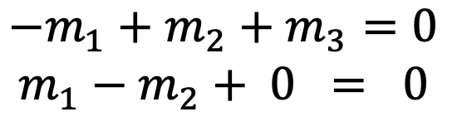
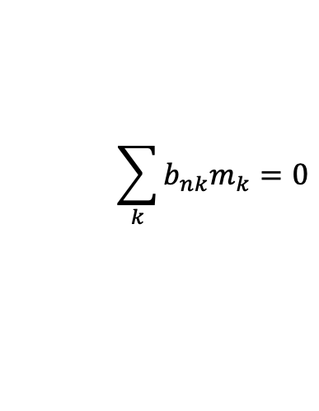






SI as a Linear Program
Linear Program
SI for ATP Hydrolysis
Constraints:
Feasibility problem: Verify constraints.
SI ⬄ Cannot solve feasibility.
Notes:
If we ignore the maximization, then this is a feasibility problem.

Slide 19

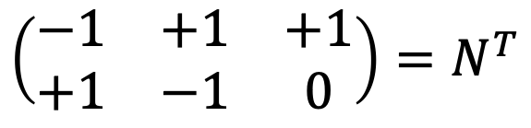
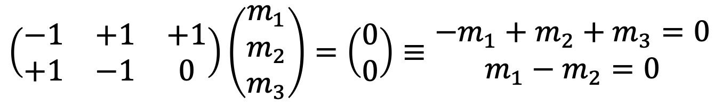
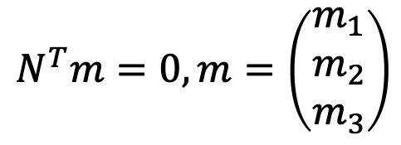
Equality constraints are determined by the stoichiometry matrix.
Transpose of stoichiometry matrix
ATP
ADP
P
R1
R2
Mass balance means that the sum of masses of reactants equals the sum of masses of the products for all reactions.
Matrix representation of the equality constraints.

Slide 20
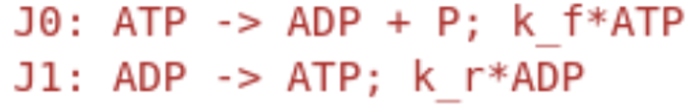
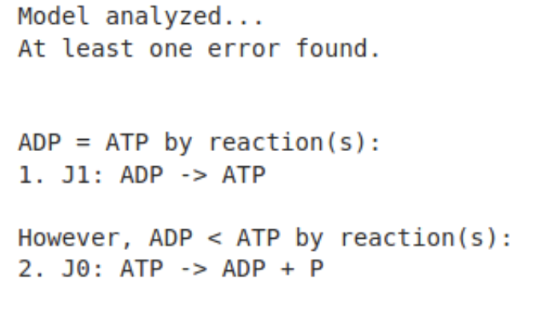
GAMES: Graphical Analysis of Mass Equivalent Sets
Isolates the cause of stoichiometric inconsistencies so that they can be resolved.
Isolation is accomplished by showing that a small subset of reactions explains the SI. These reactions are the focus for error remediation.

Slide 21
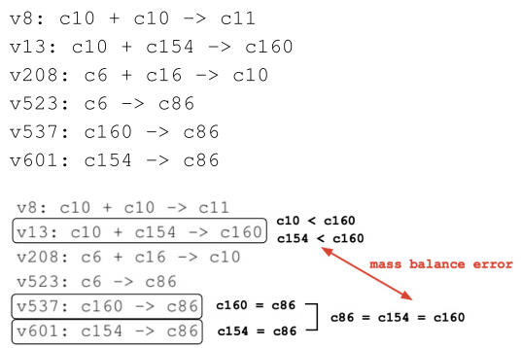
Isolating ErbB Signaling (BioModels 255)
Is there a stoichiometric inconsistency here? Where?
Isolating errors is required to remediate complex errors.

Slide 22
GAMES: Graphical Analysis of Mass Equivalent Sets
C86=c154=c160
v537, v601
v13
Graphical Algorithm
1.Form MEQs
2. Construct pseudo reactions using MEQs
3. Construct MEQ Graph, where arc means “greater than”
4. Look for and report cycles in MEQ Graph
Explain SI by the cycle.
Issue – Cannot handle multi-multi reactions.
Extended Algorithm – Incorporate multi-multi reactions.

Slide 23
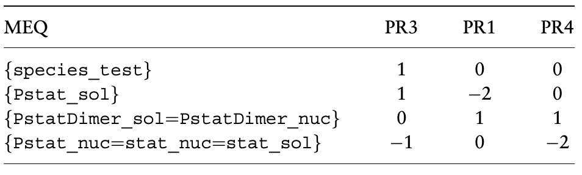
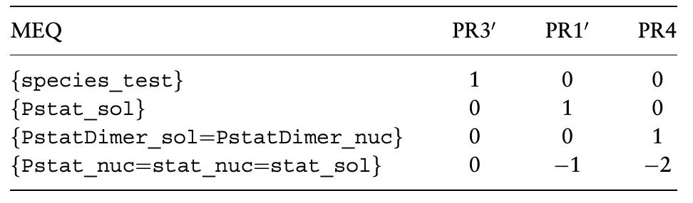
Extended GAMES
PR = Pseudo Reaction
SI exists if the non-zero terms for a PR are all of one sign.

Slide 24
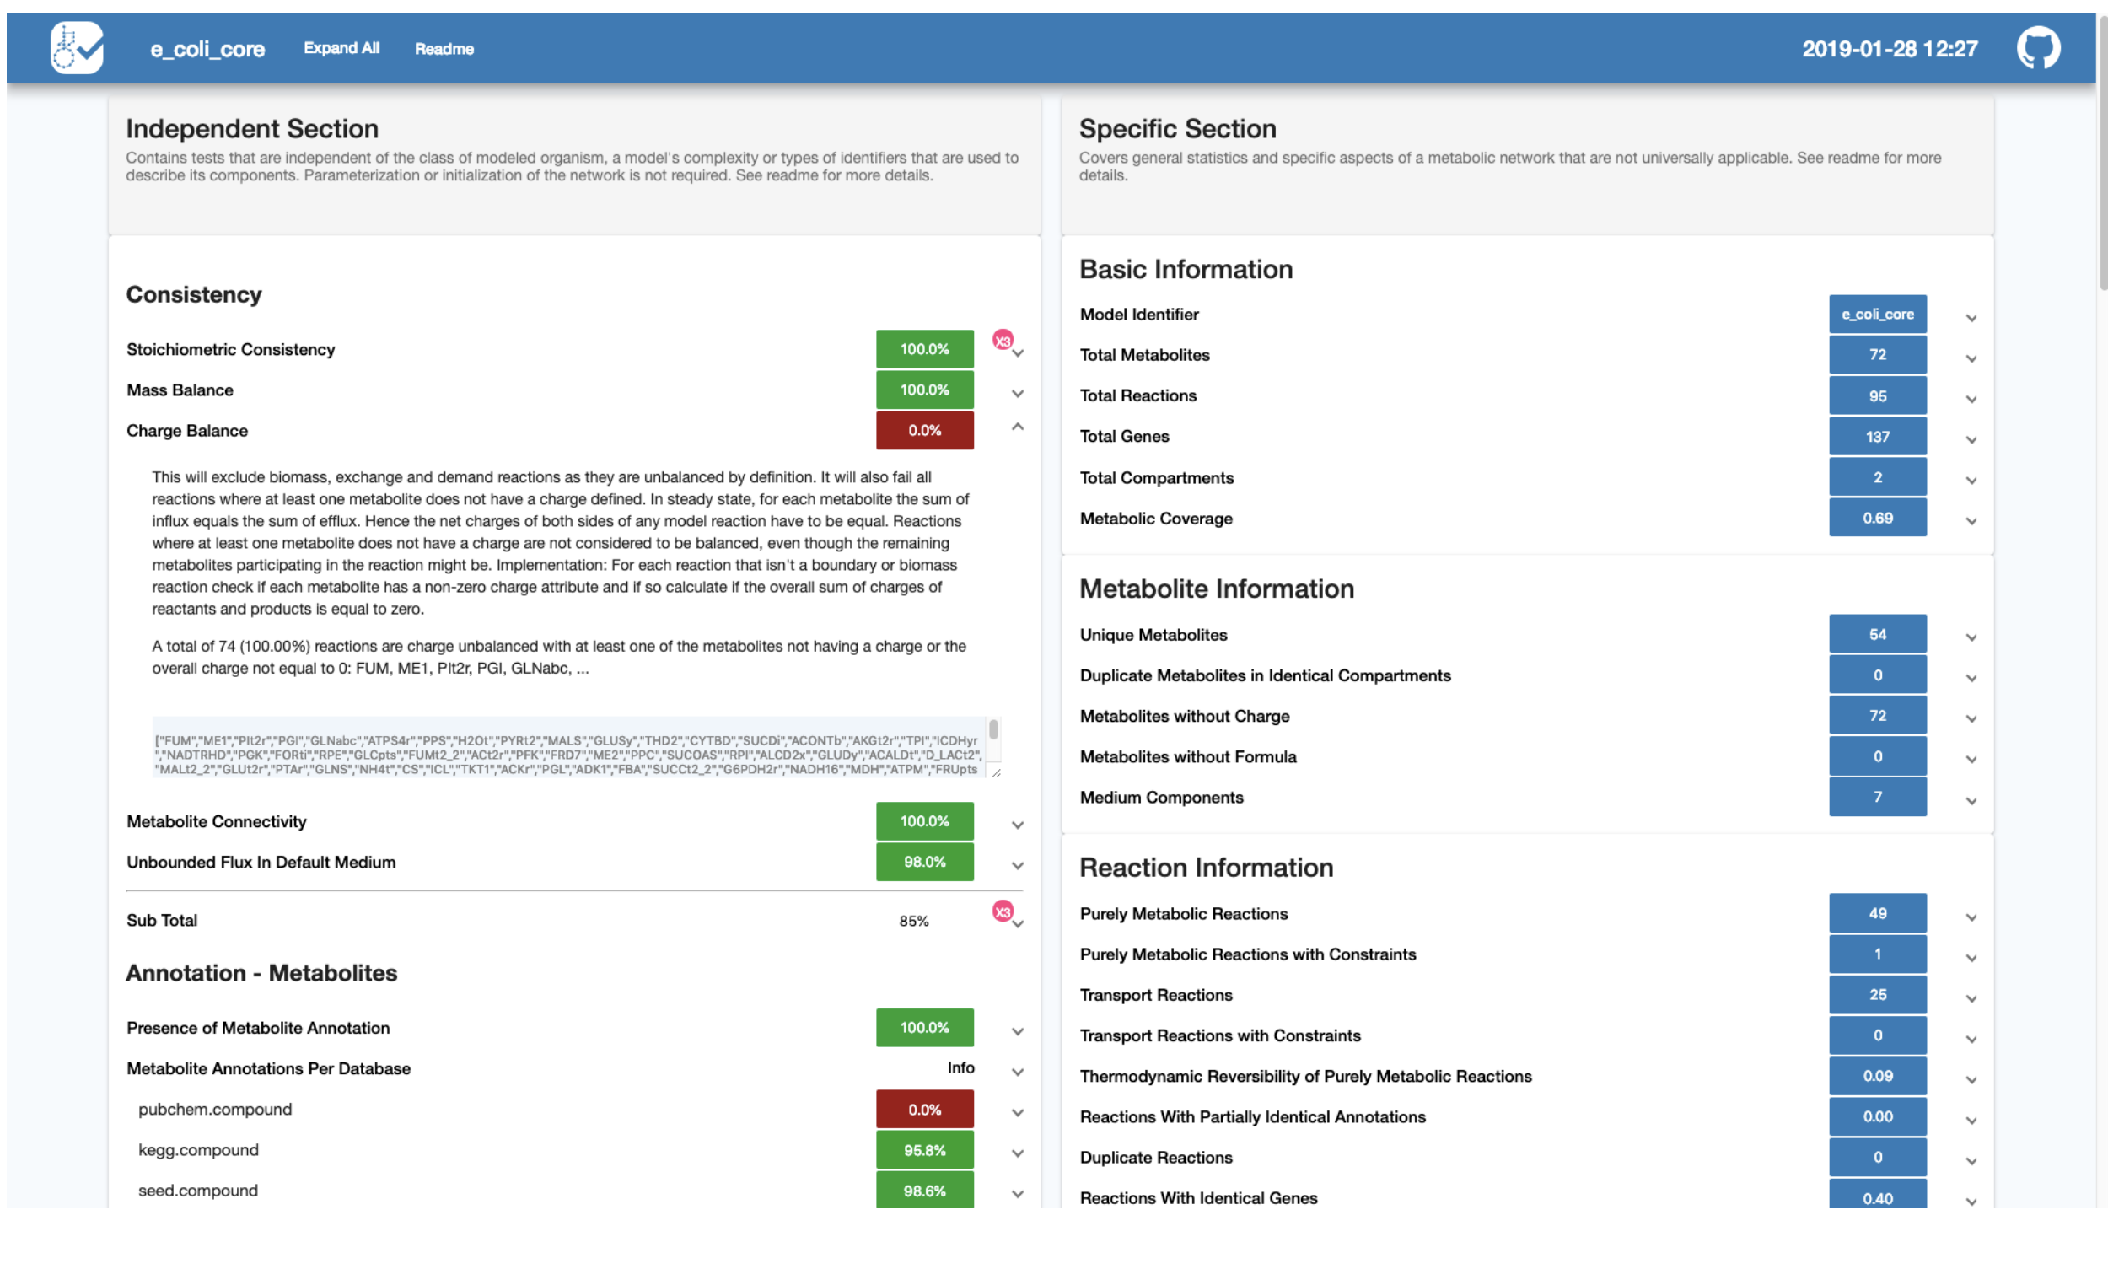
Other Static Analyses: MEMOTE*
*Nature Biotechnology, March, 2020.

